Slide 1
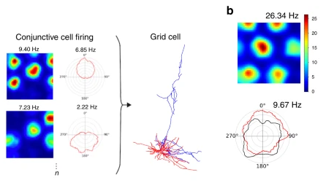
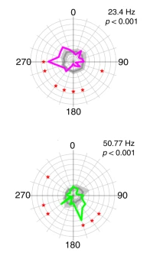
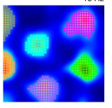
Gerlei et al 2020
Grid cells may have overall no preferred firing direction, but each grid field has a preferred firing direction
Suggest sum up many conjunctive cell input, where each conjunctive cell has non-uniform firing fields - each grid cell firing field will be influenced by some head directions over others
Suggests grid cell activity is just the collective activity of conjunctive cells -> need to focus on how conjunctive grid field come about
If this were to come about with an attractor network -> would still need a population of regular grid cells with no directional preference of firing fields
Two different types of grid cell? Attractor GCs and Summative GCs???

Slide 2
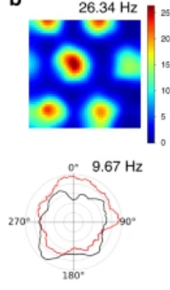
SUGGEST DIFFERENT TYPES OF GRID CELL IN DIFFERENT BRAIN REGIONS
Movement direction sensitive cells
Head direction sensitive cells from ring attractor
Non-uniform firing fields as a result of non-uniform exploration of environment -> some fields entered more often from some directions etc
Drives the bump across the sheet
Coincident input
Sum
Exc-Inh attractor network
Produces grid cells with no preferred direction even for different fields

